Slide 1

Travel Recommendation System
Group 6
Damini Prashant Vichare -Jingqi Guan- Manisha Lagisetty- Sweekruthi Balivada- Yuting Sha

Slide 2




Agenda
Abstract
Introduction
Data Collection & Pre-processing
Methodology
Code Walkthrough
Summary
Future Scope
References

Slide 3

Abstract
When looking for travel guidance, people often seek advice from friends or websites to find suggestions for places to stay, eat, and visit.
Our objective is to create a smart travel recommendation system that collects user preferences through interactions in order to offer personalized recommendations that match individual tastes.
We employ content-based and collaborative techniques to construct a recommendation system aimed at enhancing the overall travel experience.

Slide 4
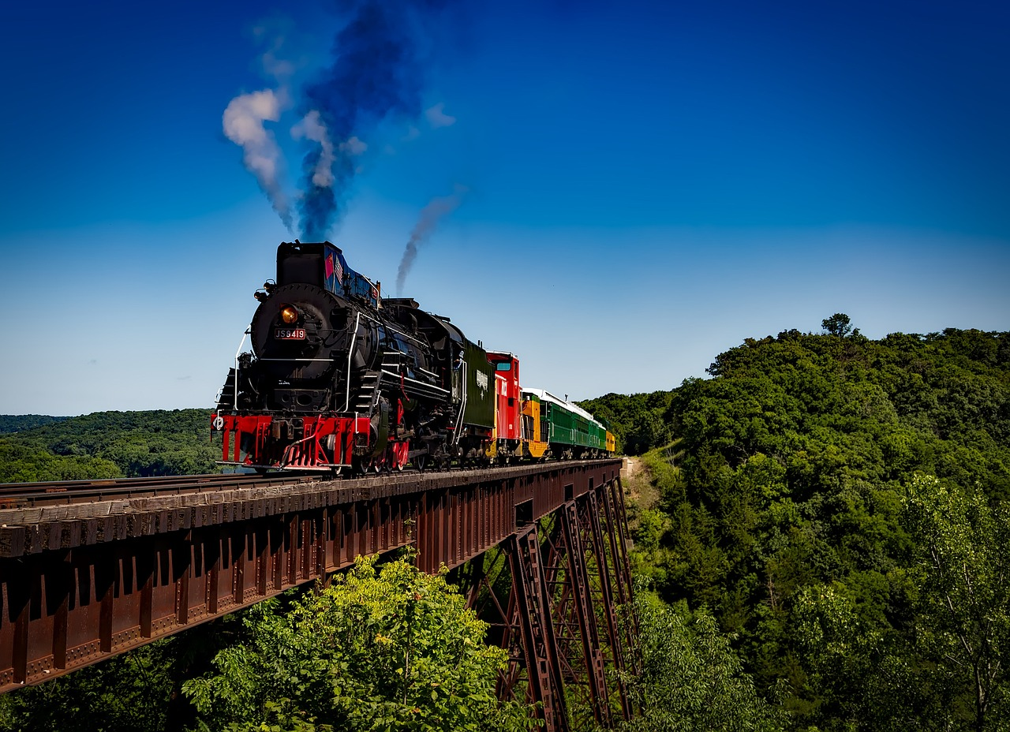


Introduction
Obtaining travel advice from personal contacts or online sources presents challenges that call for innovative solutions.
It is essential to recognize the limitations linked with conventional recommendation techniques, emphasizing the necessity for a more advanced strategy.
Numerous studies aim to establish a sophisticated and personalized recommendation system that extends beyond traditional methods.
To redefine the entire process of how travelers explore, assess, and interact with different businesses during their journeys, the aim is to utilize user interactions.

Slide 5

Data Collection
Collected data from Yelp obtained from Kaggle
https://www.kaggle.com/datasets/yelp-dataset/yelp-dataset
This dataset is subset of Yelp's businesses, reviews, and user data.
It has information about businesses in 8 metropolitan areas in the USA and Canada.
Key elements:
Businesses – This dataset contains a wide variety of establishments in many categories and regions.
Reviews – It has information about reviews, ratings, check-ins and tips which were posted by individuals.
Users – It contains all the information about the individual users.

Slide 6
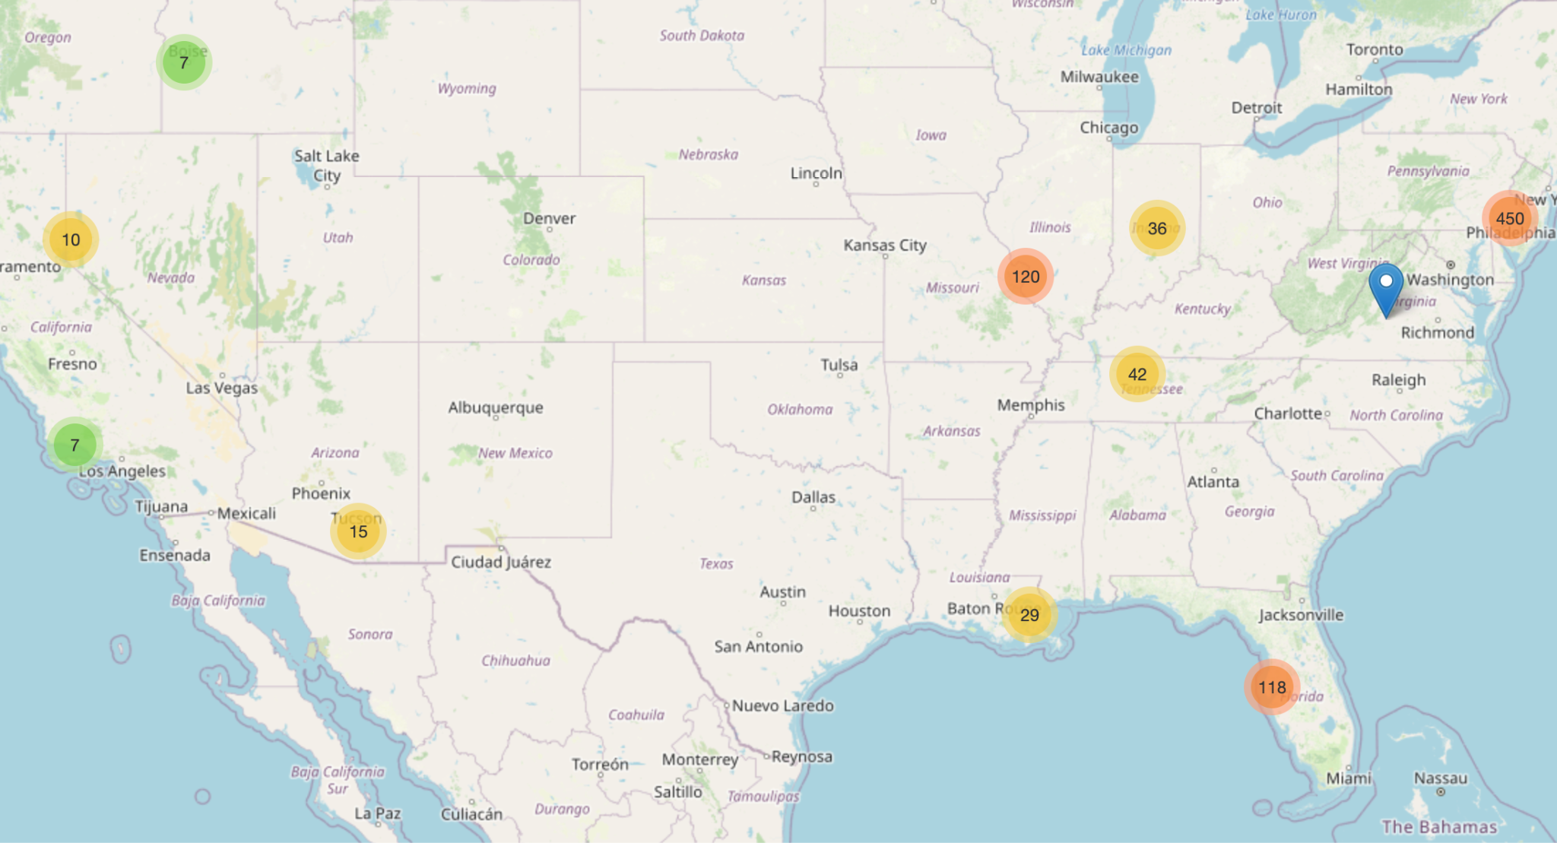
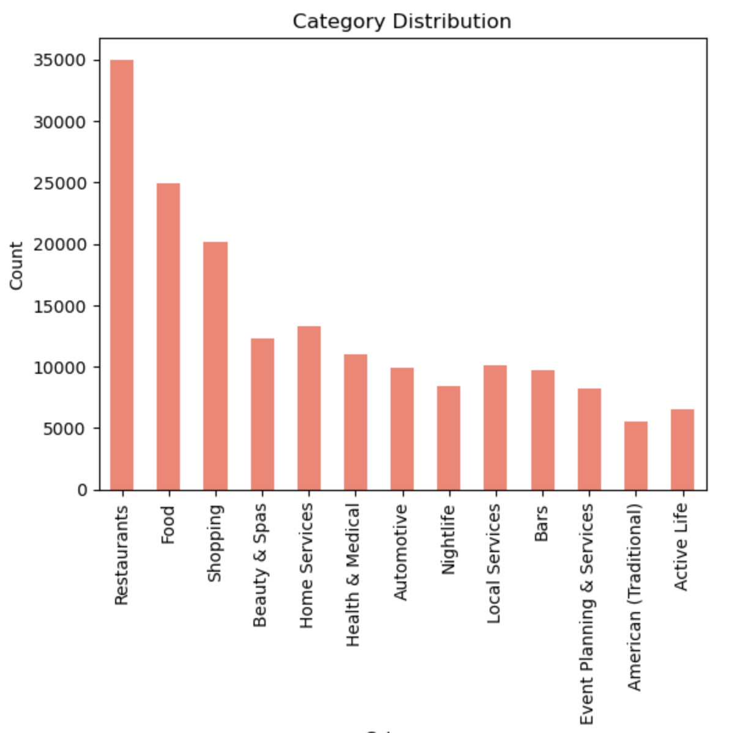
Exploratory Data Analysis

Slide 7
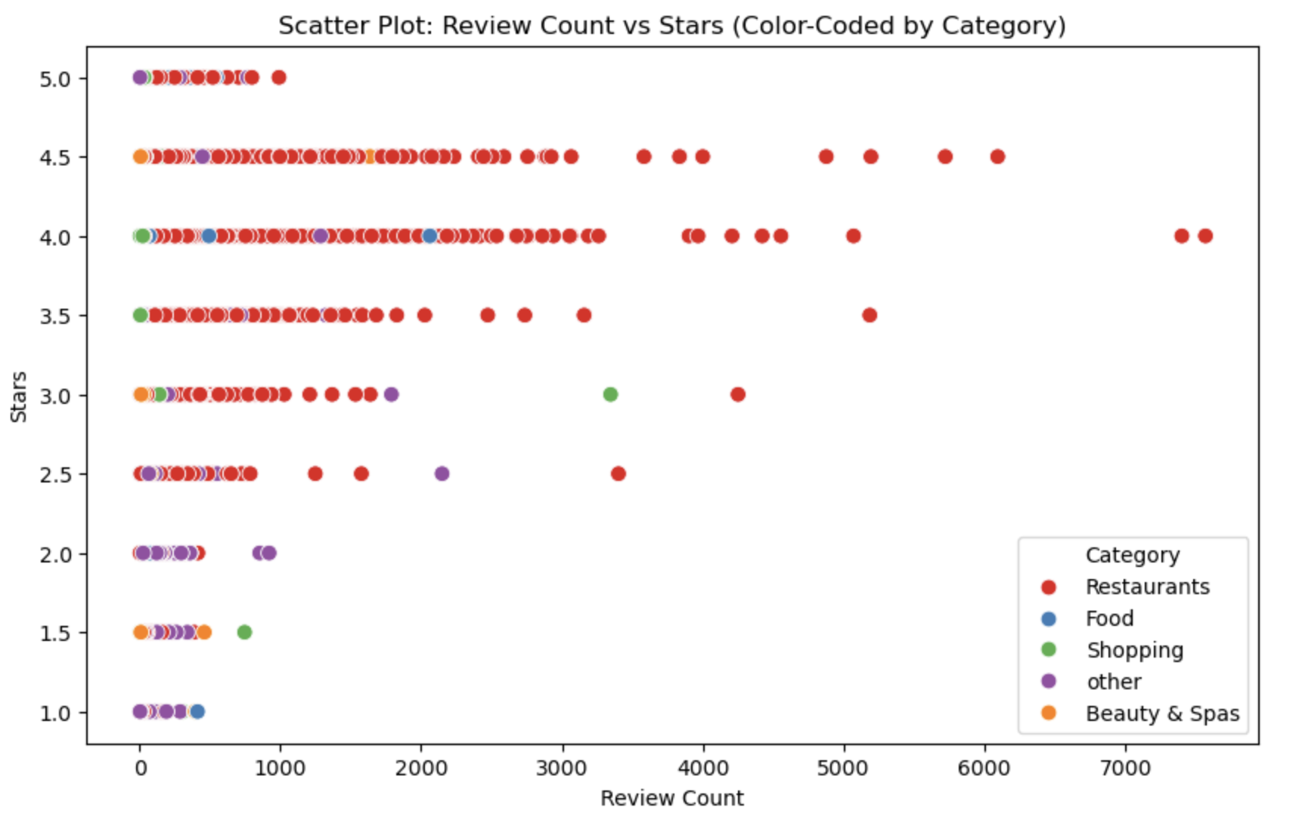
Exploratory Data Analysis

Slide 8
Methodology
In developing our recommendation system we are employing content-based and collaborative filtering approaches.
We have merged the Business, User and Review datasets for this process.

Slide 9
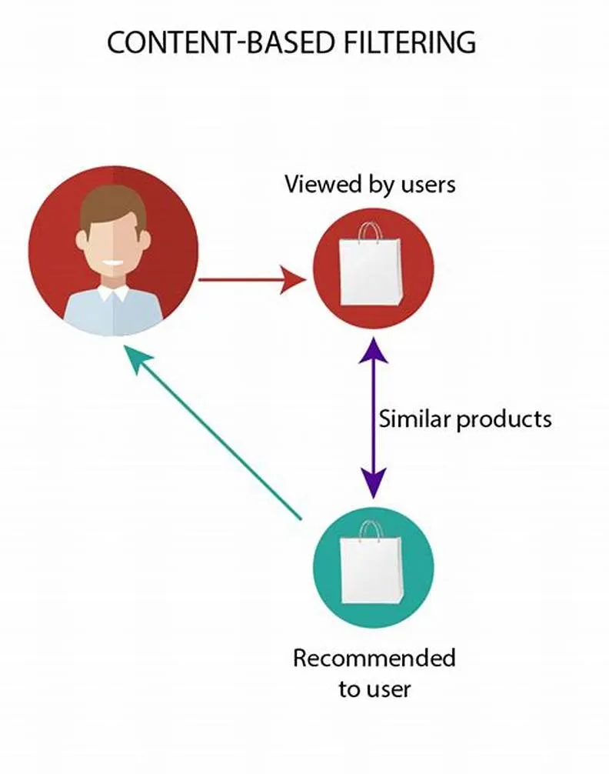
Content-based filtering
Content based filtering uses item features to recommend other items similar to what the user likes or what the user has viewed, based on their previous actions or explicit feedback.
Content based filtering is based on a description of the item and a profile of the user’s preferences. Content based filtering is best suited to situations where there is known data on an item/product (name, location, description, etc.), but not on the user.
We have followed three approaches. Approach 1 is by using Cosine similarity, approach 2 is by using Jaccard similarity and approach 3 using KNN.

Slide 10
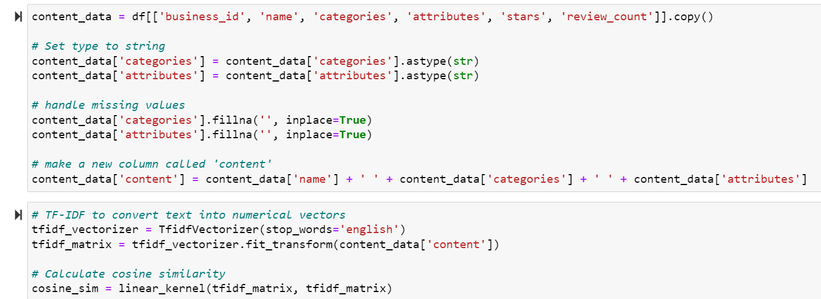
Data Preprocessing for approach 1
Feature Selection
We selected relevant columns, including business name, categories, attributes, stars, and review count.
Text Processing
To create a unified content feature, we combined the business name, categories, and attributes into a new column.
Text Vectorization
Utilizing TF-IDF Vectorizer, we converted the textual content into numerical vectors, capturing the importance of each term.

Slide 11

Content-based filtering-approach1
Function Overview
We developed a Python function to provide content-based recommendations for a given business name.
Input
Business name
Cosine similarity matrix
Content data (business information)
Similarity threshold (optional)

Slide 12
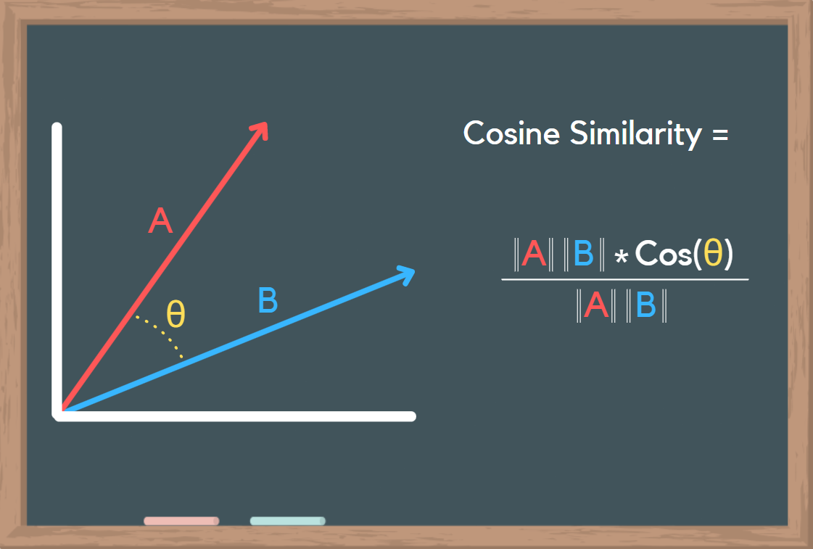
Content-based filtering-approach1
Cosine Similarity
Cosine similarity measures the similarity between two vectors of an inner product space. It is measured by the cosine of the angle between two vectors and determines whether two vectors are pointing in roughly the same direction.
We calculated the cosine similarity between businesses based on their TF-IDF vectors, establishing a measure of similarity.
Number of reviews and Star rating of similar businesses

Slide 13
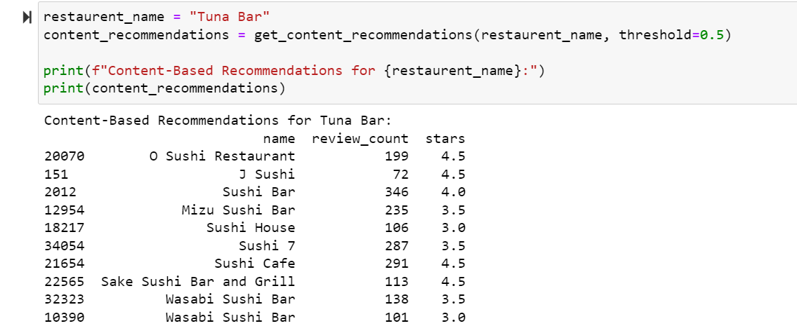
Output-approach 1
Top 10 similar restaurants similar to “Tuna Bar”

Slide 14
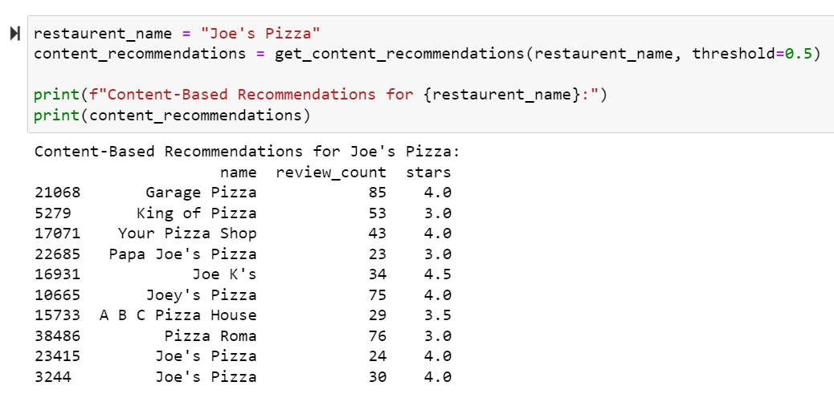
Output-approach 1
Top 10 similar restaurants similar to “Joe’s Pizza”

Slide 15
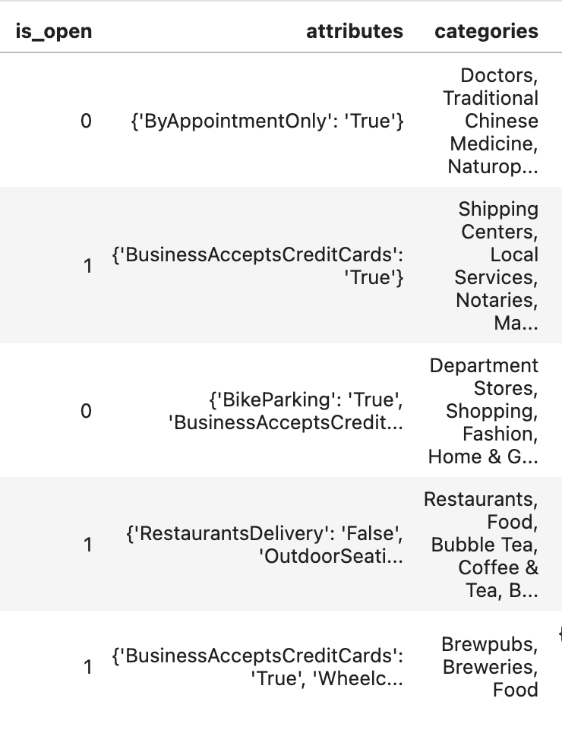
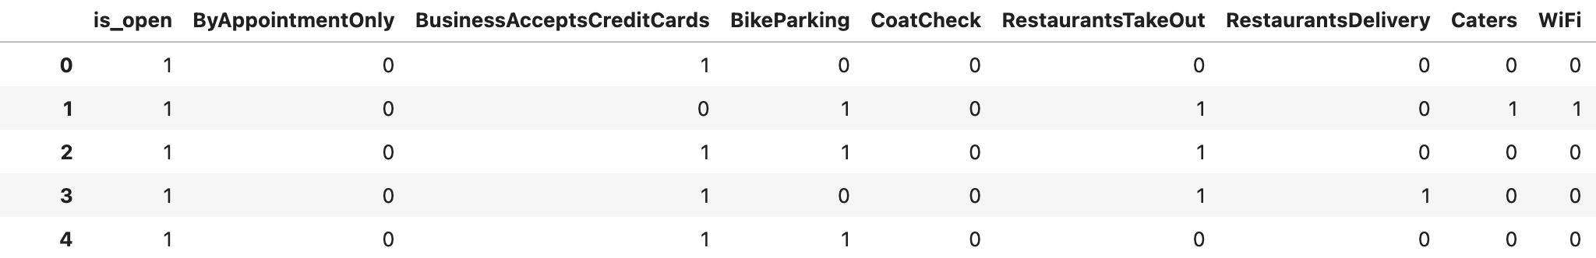
Data Preprocessing for approach 2
Data Cleaning
Dropping Missing Values
Filtering out Closed Businesses
Feature Engineering
Extract the features from those nested attributes
Split the multi-valued category

Slide 16
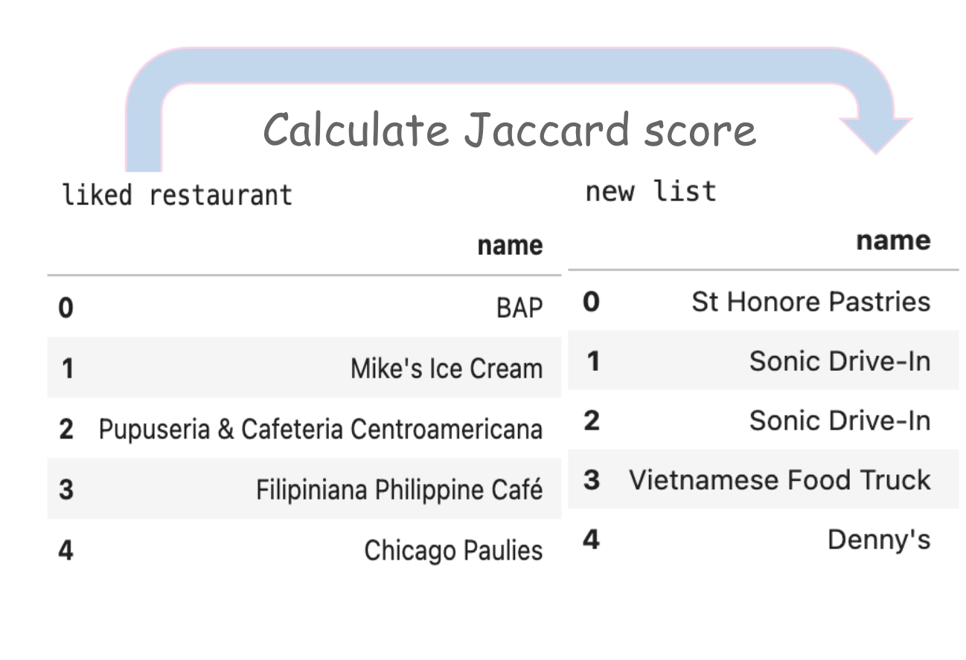
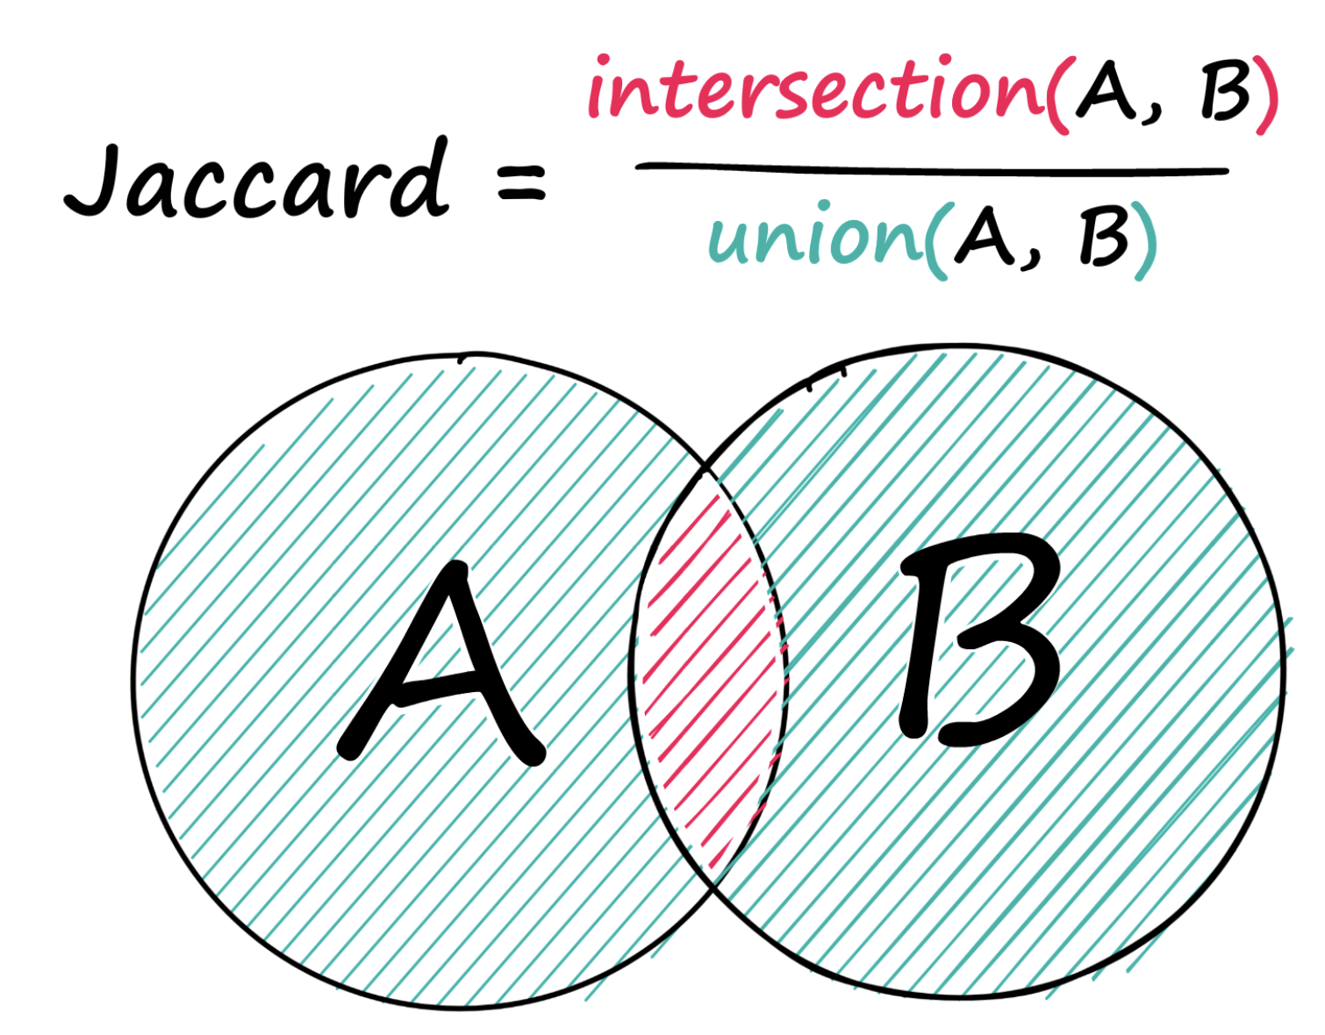
Content-based filtering approach 2
Jaccard Similarity

Slide 17

Collaborative Filtering
Collaborative Filtering (CF) is a method used in recommender systems to predict user interests by collecting preferences from multiple users. It assumes that if one user agrees with another on one issue, they are likely to agree on others.
We used 2 approaches here. First approach is using SVD and the second approach is using ALS.

Slide 18
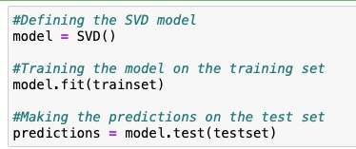
Collaborative Filtering-appraoch1
Our recommendation system utilizes Collaborative Filtering with the Surprise library and SVD algorithm.
SVD – Singular Value Decomposition.
SVD tailors predictions to individual users, enhancing the system's ability to provide accurate and personalized business recommendations.

Slide 19
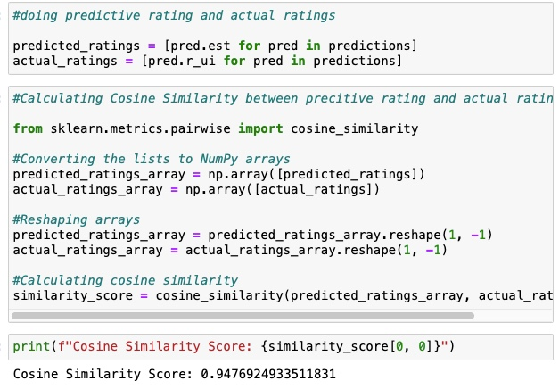
Evaluation for approach 1
Assessed model performance by utilizing accuracy metrics like cosine similarity.
Cosine similarity was calculated between actual and predicted ratings
Demonstrated the ability of collaborative filtering to make personalized recommendations by utilizing cosine similarity and evaluating performance metrics.

Slide 20
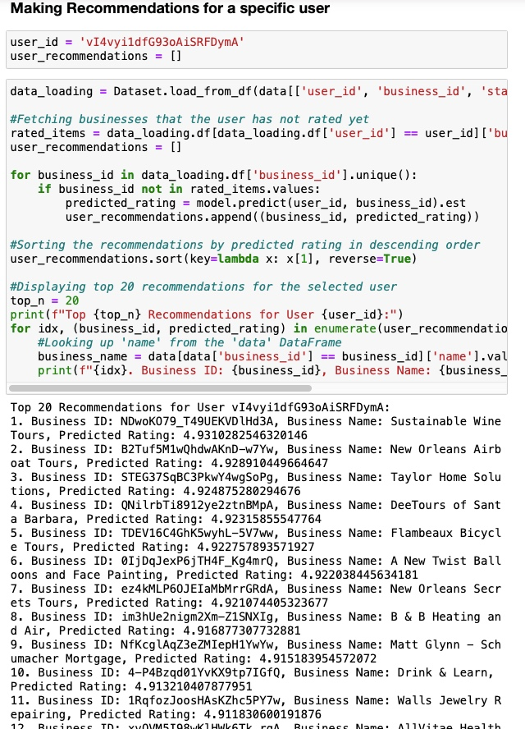
Output- approach 1
Top 20 recommendations for a Specific user is displayed when that particular user’s id is given.

Slide 21
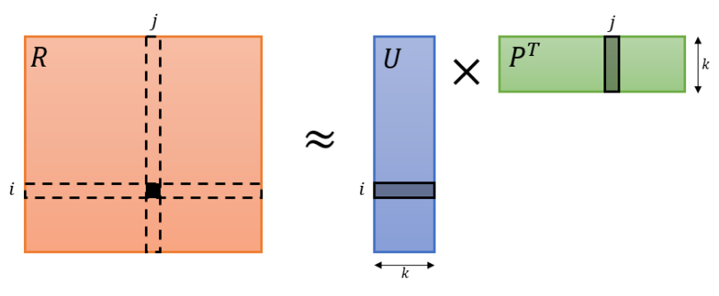
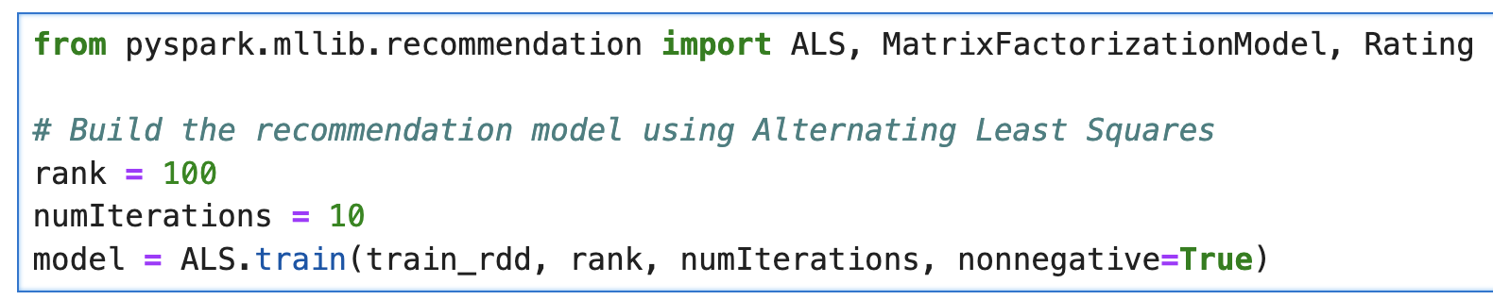
Collaborative Filtering approach 2
ALS - Alternating Least Squares
ALS is an iterative optimization process where we for every iteration try to arrive closer and closer to a factorized representation of our original data.
ALS is the solution to make the matric factorization process scalable beyond single hosts and is mostly preferred for industry use cases.

Slide 22
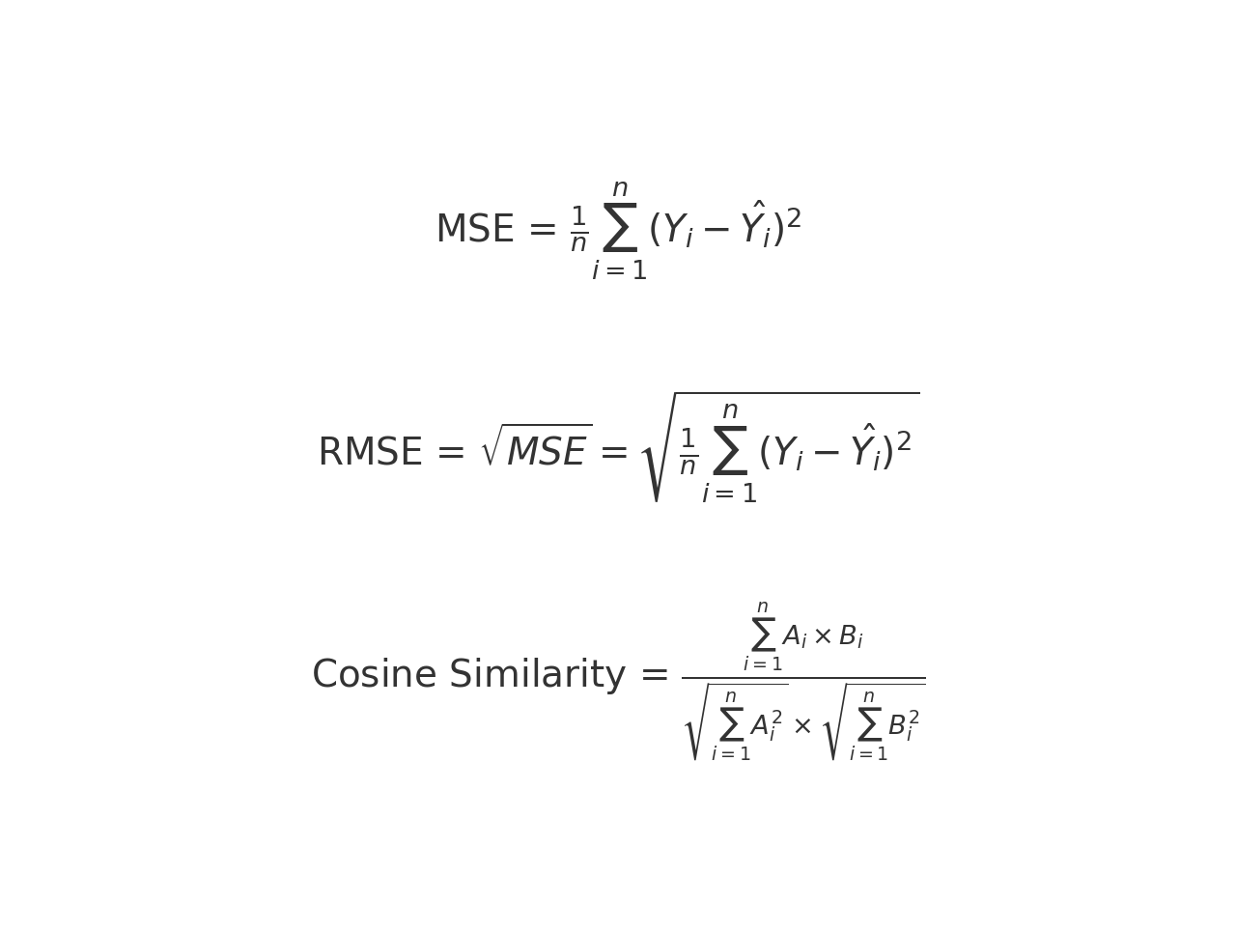
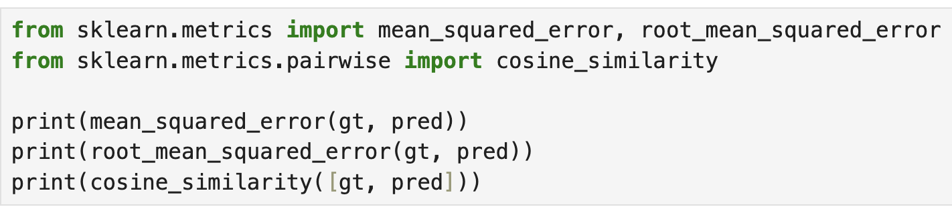
Evaluation for approach 2
Review Table provides <user, item, star> tuple.
MSE
RMSE
Cosine Similarity

Slide 23
Comparison of approaches
Algorithm | MSE | RMSE | Cosine Similarity
Collaborative (ALS) | 3.8602 | 1.9647 | 0.8839
Content-Based (KNN) | 2.2486 | 1.4995 | 0.9302
Content-Based (TF-IDF) | 2.0885 | 1.4451 | 0.9344
Collaborative (SVD) | 1.6546 | 1.2864 | 0.9476

Slide 24
Code-walkthrough

Slide 25

Summary
Our project represents a substantial advancement in developing customized travel suggestions using the extensive dataset from Yelp. Content-based recommendations provide businesses similar to a given one based on textual features. Adjusting the similarity threshold allows customization of recommendation sensitivity. The focus on collaborative filtering, executed through the Surprise library, establishes a robust basis for precise forecasts that cater to specific user preferences.

Slide 26

Future Scope
Our travel recommendation system is designed to evolve and cater to user preferences. In the future, we could improve accuracy by incorporating advanced machine learning techniques like deep learning. To further enhance user engagement, features such as sentiment analysis and real-time updates can be included. Expanding the dataset to cover more geographical areas and diverse businesses would make our recommendation system globally relevant.

Slide 27
References
Adeniyi, David Adedayo, Zhaoqiang Wei, and Yang Yongquan. "Automated web usage data mining and recommendation system using K-Nearest Neighbor (KNN) classification method." Applied Computing and Informatics 12.1 (2016): 90-108.
Hayes, Conor, and Pádraig Cunningham. "Context boosting collaborative recommendations." International Conference on Innovative Techniques and Applications of Artificial Intelligence. London: Springer London, 2003.
Wang, Yaozheng, et al. "A mobile recommendation system based on logistic regression and gradient boosting decision trees." 2016 international joint conference on neural networks (IJCNN). IEEE, 2016.
Linden, Greg, Brent Smith, and Jeremy York. "Amazon. com recommendations: Item-to-item collaborative filtering." IEEE Internet computing 7.1 (2003): 76-80.

Slide 28

Thank you

